Slide 1
Saint-Gobain
Challenge ROADEF/EURO
2018-2019
23/02/2018
Lydia Tlilane & Quentin Viaud
Datalab, Saint-Gobain Recherche

Slide 2

Outline
Introduction
Context
Problem description

Slide 3
Outline
Introduction
Context
Problem description

Slide 4

Key figures
2016 net sales
€39.1 BN
More than170,000 employees
and 100+ nationalities
represented
Present in
67 countries
Around 4,100
sales outlets
More than 80% of sales
are made in the habitat markets: construction, renovation, infrastructures and civil engineering
One of the top100 industrial groups in the world with around 950 production sites
Created more than
350 years ago

Slide 5

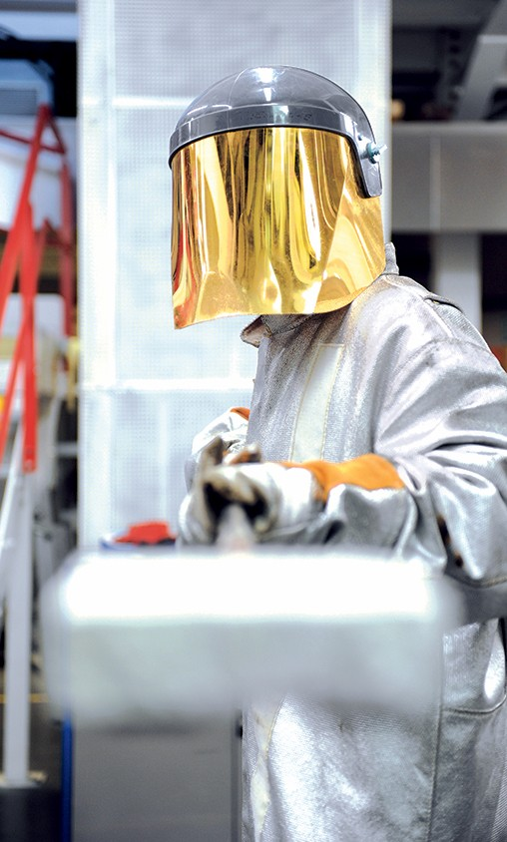

25%
of net sales
Innovative materials
  Comprising Flat Glass and High-Performance Materials, the Innovative Materials Sector holds a unique portfolio of materials and processes relating to habitat, transport, healthcare and industry markets. It provides the Saint-Gobain Group with its innovation-oriented culture.
Flat glass
  N°1 in Europe
  N°2 worldwide
  Present in 33 countries*
  Over 33,000 employees
High-Performance materials
  N°1 worldwide
  Present in 36 countries*
  Over 27,000 employees
* Industrial presence

Slide 6


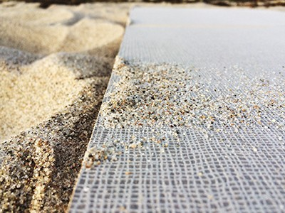










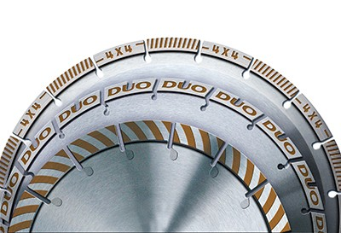







Innovative materials
MAIN BRANDS
PRODUCTS AND ARCHITECTURAL PROJECTS
FLAT GLASS
TECHNICAL TEXTILES
FIRE RESISTANT GLASS
AUTOMOTIVE GLAZING
ELECTROCHROMIC GLASS
The four cockpit windows and 32 passenger windows of the Falcon 8X are supplied
by Saint-Gobain Sully
ABRASIVES
Novelio Nature
Range of fiberglass wall coverings from Saint-Gobain Adfors
WINDOW FILM
FLEXIBLE TUBING
ARCHITECTURAL
MEMBRANES
BEARINGS
ADHESIVE FOAMS
CERAMICS FOR ENERGY
CONTRAFLAM®
Fire-retardant and anti-UV glazing by Vetrotech in the futuristic boarders’ residence in Le Rosey, Geneva, designed by Bernard Tschumi
POLYMER SEALS
NORTON I-HD
New technology from Saint-Gobain Abrasives that is revolutionizing the market for diamond tools
REFRACTORIES

Slide 7

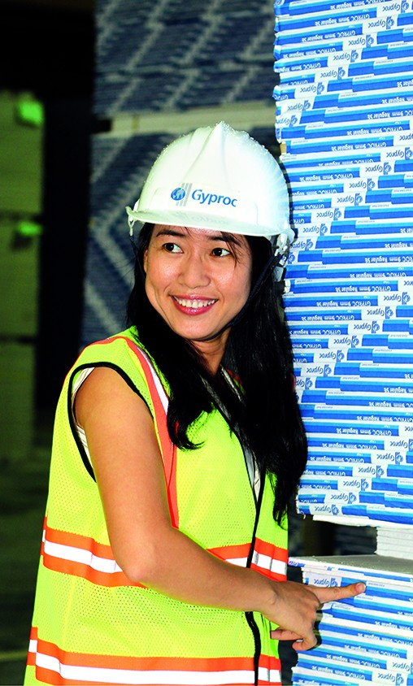
28%
of net sales
Construction products
  The Construction Products Sector designs and develops innovative solutions to improve the quality of living places and reduce the environmental impact of buildings, with unique product and service offerings for all construction fields, tailored to local conditions.
  N°1 worldwide
      Plaster and plasterboard
      Insulation (all types of insulation products)
      Tile adhesives
      Industrial mortars
      Ductile cast iron pipe
  N°1 in Europe
      Wall facings
  N°2 in the United States
      Siding
  Present in 62 countries*
  Over 46,000 employees
* Industrial presence

Slide 8
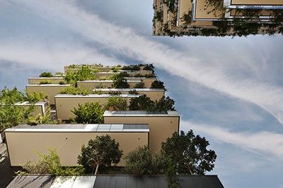


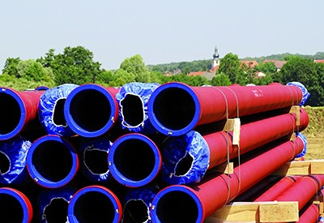




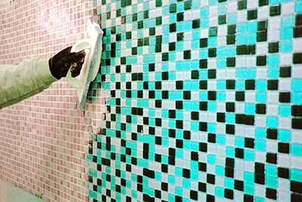


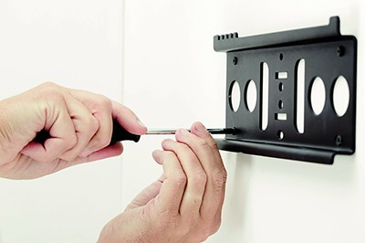




Construction products
MAIN BRANDS
PRODUCTS AND ARCHITECTURAL PROJECTS
TOPAZ
Saint-Gobain PAM’s complete ductile iron pipe system for wastewater collection networks
INSULATION
RENDERS AND MORTARS
INETRIOR AND EXTERIOR
SOLUTIONS
COMPLETE PIPE SYSTEMS
2015 – Italy
Glass wool panels to insulate the façades of the Bosco Verticale in Milan
PASTERBOARD AND
GYPSUM
ACOUSTIC CEILINGS
HABITO
Plasterboard that allows objects to be easily attached to the wall without using any specific attachment system
weber.epox easy
Ceramic tile adhesive and grout

Slide 9


47%
of net sales
Building distribution
  The Building Distribution Sector brings the Group a thorough understanding of customers’ needs, be they building professionals, private project owners or large companies. It serves over seven million customers each year on the new building, renovation and home improvement markets.
  N°1 in Europe
  Distribution of building materials
  Present in 24 countries
  Over 61,000 employees
  Around 4,100 sales outlets

Slide 10
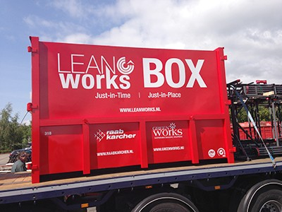








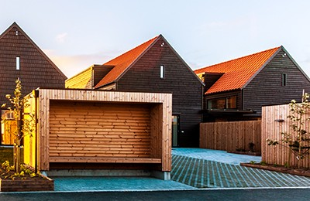
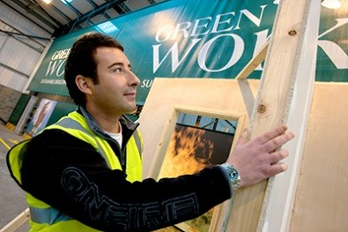

Building distribution
MAIN BRANDS
SERVICES
LeanWorks
Logistics solution developed by Raab Karcher in the Netherlands
FRANCE
EUROPE
UNITED KINGDOM
HomlyYou
A website in France which puts individuals with a work project into contact free-of-charge with a network of qualified, experienced trade professionals
SCANDINAVIA
GERMANY/
CENTRAL EUROPE
BRAZIL
2015 – Norway
Three Multi-Comfort houses built by the Optimera and Dahl brands
Greenworks Training Academy
Customers training in sustainable building in the United Kingdom
MinOptimera
Self-service estimation tools for building and public works SMEs available on the Optimera brand’s interactive website

Slide 11

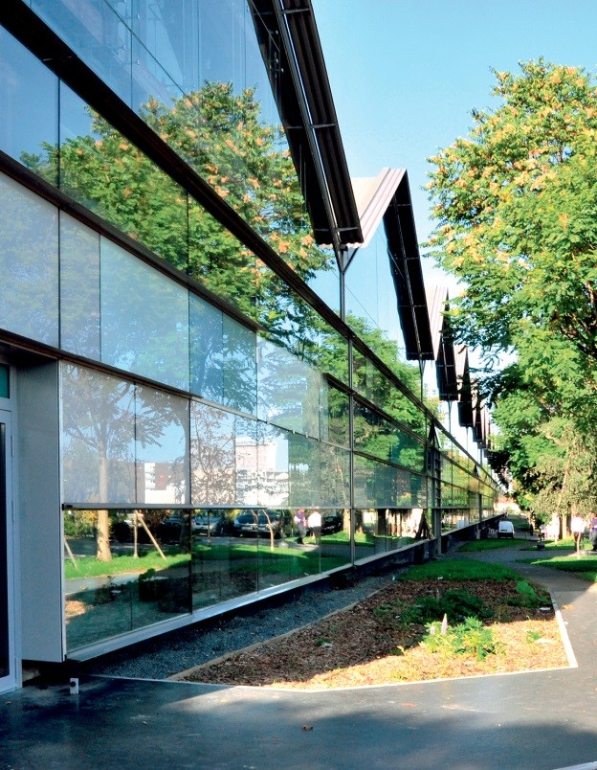

WE HELP TO CREATE
GREAT LIVING PLACES AND IMPROVE DAILY LIFE
BY COMBINING
    COMFORT
    SUSTAINABILITY
    WHICH ANSWERS TODAY’S INDIVIDUAL NEEDS
    (performance, safety, adaptability, accessibility, beauty)
    WHICH ADDRESSES TOMORROW’S COLLECTIVE CHALLENGES
    (sustainable building, better mobility, resource efficiency, demographic growth, climate change)
TO ENHANCE THE WELLBEING OF PEOPLE EVERYWHERE

Slide 12

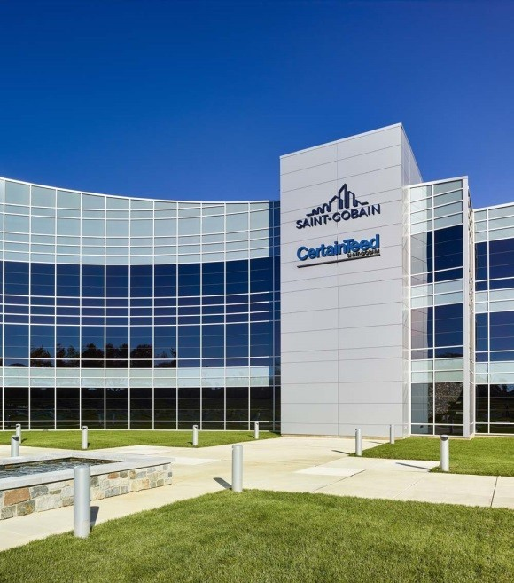
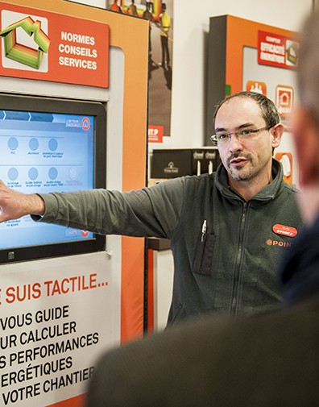

A passion for materials
Efficient and innovative and performance materials
Materials for comfortable and sustainable buildings
Expert employees on materials and markets

Slide 13
Saint-Gobain Recherche
One of the top
100 global innovators
8 cross-business R&D centers
SAINT-GOBAIN RECHERCHE
Herzogenrath Germany
Northboro
USA
Shanghai
China
3,700
people
Chantereine France
Cavaillon
France
More than 380 patents
in 2016
Chennai
India
Capivari
Brazil
Around 100 development units
Academic and start-up partnerships
1 out of 4 products
sold today by Saint-Gobain did not exist 5 years ago

Slide 14
Datalab – Applied Maths. team
Mission : Bring value to all Saint-Gobain businesses through the use of data science and digital skills
Scope : Sales, Marketing, Supply-chain, Production, R&D, Building science
Core competencies : Optimization, Data science, Virtual reality, Coding

Slide 15
Outline
Introduction
Context
Problem description

Slide 16



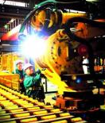

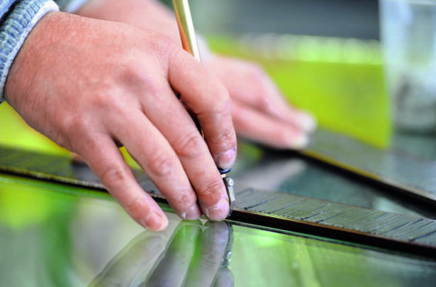
Saint-Gobain Glass France
Approx. 300
MANUFACTURING FACILITIES
#1 in Europe
#2 worldwide
Manufacture and sale of flat glass, processing and distribution of glass solutions for the construction, automotive and transportation industries
Specific organization and salesforce for each market segment
Solutions to the challenges of environmental protection, aesthetic design, comfort, ergonomics and safety
Products and services tailored to the specifics of each local market and customer services that make the most of the opportunities provided by digital technology
Over
33,000 EMPLOYEES
Sales and manufacturing operations in 42 COUNTRIES
Sales €5.4bn

Slide 17


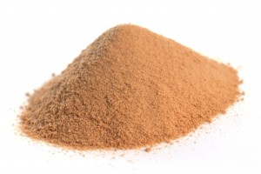
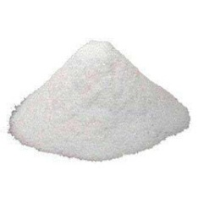


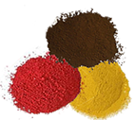
How to make glass ?
Sand
SiO₂
700 kg
Sodium
carbonate
Na₂CO₃
250 kg
Limestone
CaCO₃
200 kg
Others
50 kg
Glass
1000 kg
CO₂
200 kg
SiO₂ + Carbonates + ε → Silicate + CO₂

Slide 18
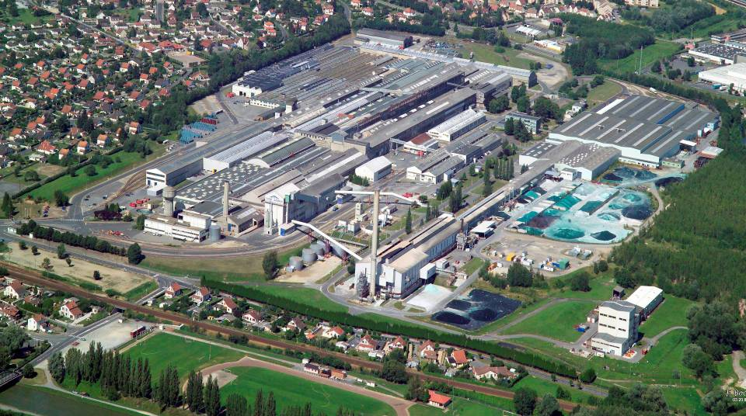
How to make glass ?
Warehouse
Cutting shop
Annealing lehr
Float (tin bath)
Batch house
Furnace

Slide 19
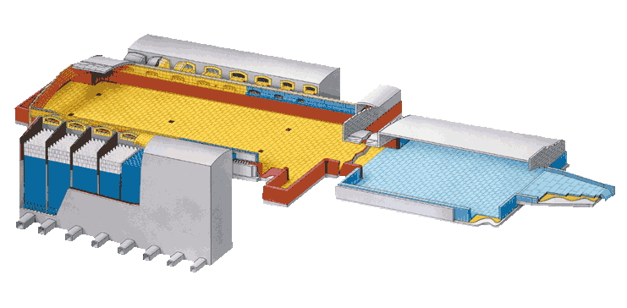
How to make glass ?
Melting — 800°C to 1300°C
Raw materials → inhomog. liquid Various chemical reactions
Fining — 1300°C to 1500°C
Removal of bubbles
Homogenisation
H ≈ 1 m
P ≈ 50 MW
L ≈ 70 m
w ≈ 10 m
Copyright SEPR
Thermal conditioning — 1500°C to 1100°C
Controlled cooling to forming T°C
19

Slide 20
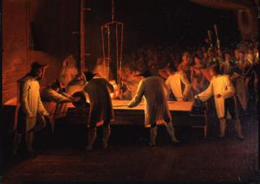
How to form glass ?

Slide 21
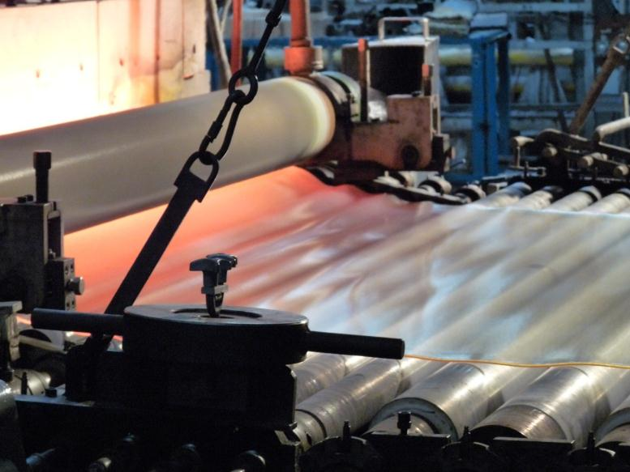
How to form glass ?

Slide 22
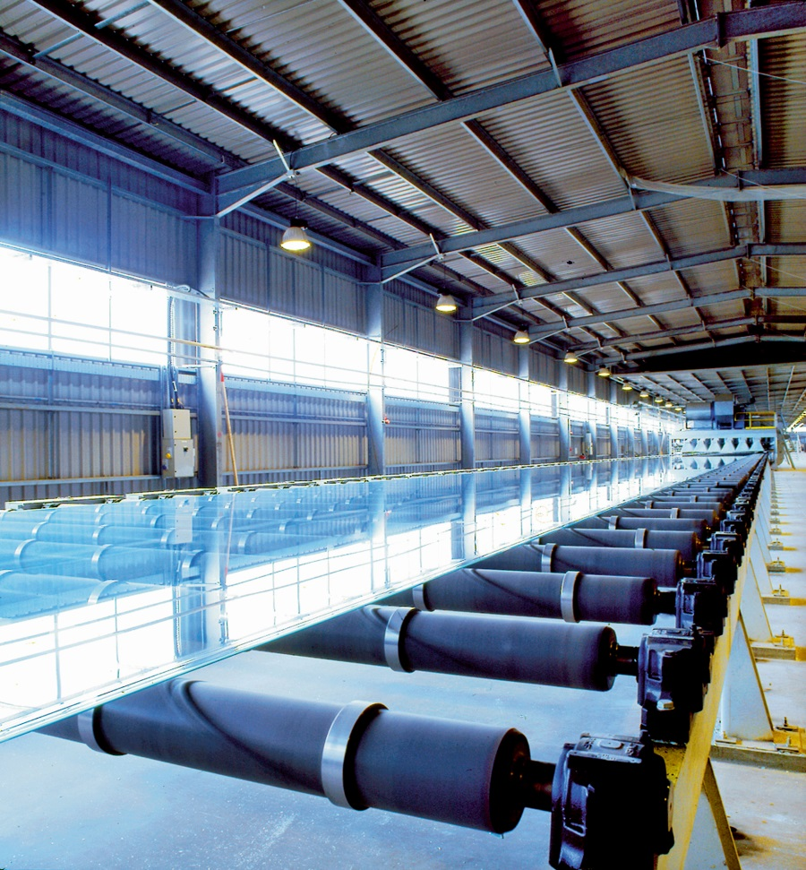
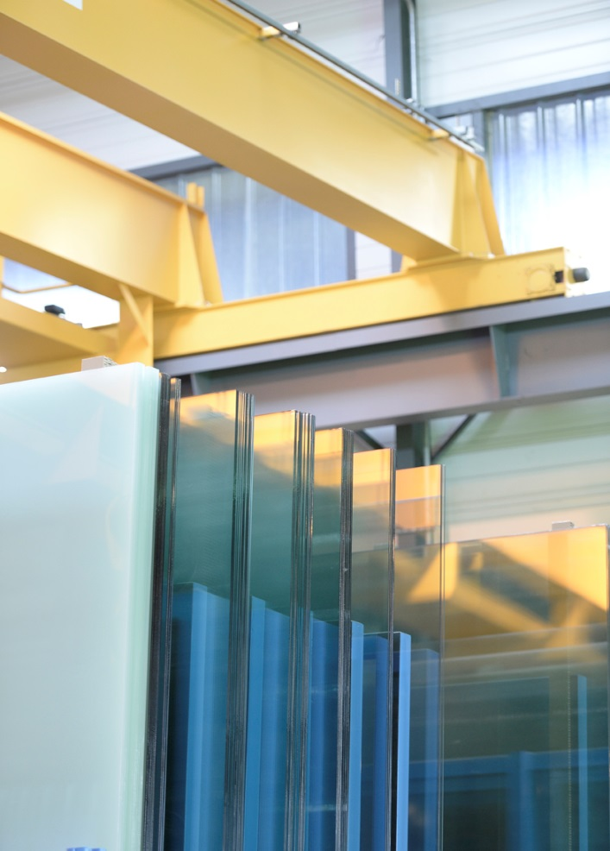
How to store glass ?
Cutting and storage

Slide 23
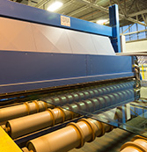
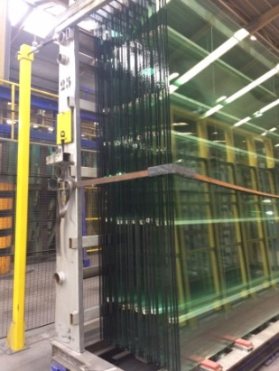
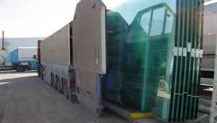
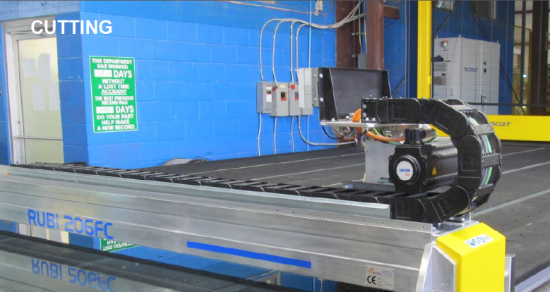
What happens to the glass next ?
The glass float is cut in jumbo’s of standard size (3m x 6m)
Jumbo’s are then stacked and sent to transformers
Transformers cut jumbo’s in smaller glass pieces.
Glass pieces are then sold to customers to match their needs (e.g. your home windows)

Slide 24
Production problems …
Defects arise on jumbo’s due to:
The complicated glass metling process
The moving of jumbo’s
Defects are of different types:
Air bubbles trapped in the glass
Cracks or impacts from moving
Stone (not melted material)

Slide 25
Concerns
Make our customers happy ➔ Do not produce a glass piece having defects
Remain competitive ➔ Reduce glass loss

Slide 26
Outline
Introduction
Context
Problem description

Slide 27
Problem
Input : a set of jumbo’s with their defects and a set of glass pieces to cut
Objective : design a set of cutting patterns for the jumbo’s of minimal glass loss
Constraints :
Cut all pieces ordered by a customer
Each piece has to be defect free
Respect cutting and organisationnal constraints
This problem is a two-dimensional bin-packing problem (a jumbo = a bin, a glass piece = an item)

Slide 28
Constraints
Two sets of constraints :
Cutting , from technical limitation and glass property
Organisationnal, from organisation in production units

Slide 29
Cutting constraints
Only guillotine cuts are allowed
2
3
5
1
2
4
5
4
1
3
Guillotine
Non guillotine

Slide 30
Cutting constraints
The number of cuts to obtain an item is at most 3
3-cut
2
4
2
3
5
2-cut
1
2-cut
2-cut
4
2-cut
1
3
1-cut
1-cut
Allowed
Allowed

Slide 31
Cutting constraints
Only one extra cut is allowed after a 3-cut to remove waste
3-cut
3-cut
2
3
5
3
5
4-cut
2
2-cut
2-cut
2-cut
4
2-cut
4
1
1
1-cut
1-cut
Allowed
Allowed

Slide 32
Cutting constraints
Only one extra cut is allowed after a 3-cut to remove waste
3-cut
3-cut
3
5
4-cut
3
5
6
4-cut
4-cut
2
2
2-cut
2-cut
2-cut
4
2-cut
4
1
1
1-cut
1-cut
Allowed
Forbidden

Slide 33
Cutting constraints
Extra cutting constraints :
Limits on minimal and maximal cut lengths depending on cutting stages
Limits on the minimum dimension of a waste
Interdiction to cut through defects

Slide 34
Organisationnal constraints
Bins have the same size and may contain rectangular defects
Bins are stacked and have to be considered as ordered when designing cutting patterns
Bin 1
Bin 2
Bin 3

Slide 35
Organisationnal constraints
After cutting, items are put on sillages and send to production units next
They have to be cut in a given order (a stack) to respect production planning
^{i}_{1,1}
^{i}_{1,2}
^{i}_{1,3}
^{i}_{1,4}
^{i}_{2,2}
^{i}_{2,1}
^{i}_{2,3}
^{i}_{3,1}
^{i}_{3,3}
Stack 1
Stack 2
Stack 3
Stack 4

Slide 36
Problem
The problem to deal with is a two-dimensional bin-packing problem with :
Defects on bins
Order on bins
Order on items
Considering unrestricted 3-stage guillotine cutting patterns with trimming

Slide 37
Problem
Find a set of cutting patterns ensuring all constraints and of minimal loss (dashed lines)
^{i}_{2,3}
^{i}_{2,1}
^{i}_{2,2}
^{i}_{1,2}
^{i}_{1,3}
^{i}_{1,4}
^{i}_{1,1}
^{i}_{3,1}
^{i}_{3,3}
Bin 1
Bin 2
Bin 3

Slide 38
Problem
Find a set of cutting patterns ensuring all constraints and of minimal loss (dashed lines)
^{i}_{3,3}
^{i}_{2,1}
^{i}_{1,4}
^{i}_{1,3}
^{i}_{2,3}
^{i}_{3,1}
^{i}_{1,1}
^{i}_{1,2}
^{i}_{2,2}
Bin 1
Bin 2
Bin 3

Slide 39
Problem size
A typical problem instance is composed of :
A set of bins of size (3m x 6m) with defects (≈ 3 defects per bin)
≈ 300 items to cut and ≈ 22 item stacks

Slide 40
Challenge - Roadmap
Feb. 2018 – Start qualification phase and sprint
Mar. 2018 - Release of Dataset A and checker
23rd May 2018 – End of sprint
1st June 2018 – Announcement of sprint results
EURO 2018 – Sprint awards
23rd Sept. 2018 – End of qualification phase and release of Dataset B
23rd Oct. 2018 – Start final phase for qualified teams
15th Jan. 2019 – End of final phase
ROADEF 2019 – Results announcements and release of Dataset X
March 2019 – Paper submission for scientific price
EURO 2019 – Challenge awards

Slide 41
Challenge - Tools
Evaluation of algorithms based on geometric loss: 3 min. (10%) + 1h. (90%)
Three datasets :
A – 20 instances
B – 15 instances
X – 15 instances
Available tools :
Checker
Visualization

Slide 42
Challenge – Prices
Sprint phase – 5000€
Qualification phase – 5000€
Junior team final phase – 10000€
Best team final phase – 10000€
Open source price – 10000€
Scientific price – 5000€
45000 €

Slide 43
Questions ?

Slide 44
Intellectual property
Participants have intellectual property on their computer programs developed during the challenge. Saint-Gobain Glass France and any third party may use information provided by the participants through technical reports, scientific papers and oral presentations, but cannot use a computer program without the agreement of the team who wrote this program.
Participants to the challenge cannot claim to have a partnership or a contract with Saint-Gobain Glass France or any entities of the Saint-Gobain Group, even if they win the challenge. They can only claim to be participants (respectively qualified / winner) if it is the case.
Saint-Gobain Glass France may (but has taken no engagement to) sign contracts with some participants after the challenge. Any such contract would be independent of the challenge.

